Slide 1


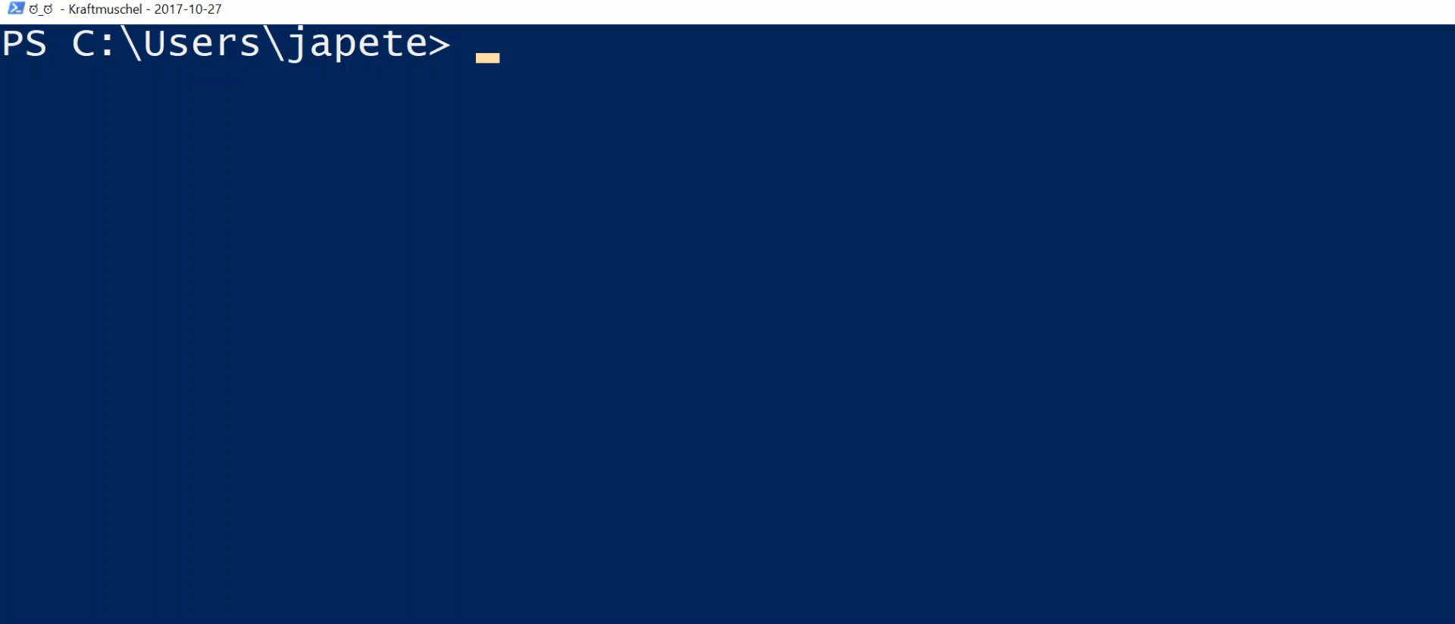





2017
Hands-On JEA
Build an immutable application infrastructure with Nano Server, PowerShell DSC, and the
release pipeline
We want to give you the chance to introduce and advertise yourself. Use the space inside this text box with a bio, picture, personal email, as you like.
This is strictly personal, do not abuse as free advertisement for your employer or other 3rd party.
While you can say that you are working for company ABC, you cannot say that ABC is a wonderful company providing the worlds‘ best services for XYZ. While you can show your email address, do not use a company generic email address like sales@xyz.com
Ravikanth Chaganti

Slide 2
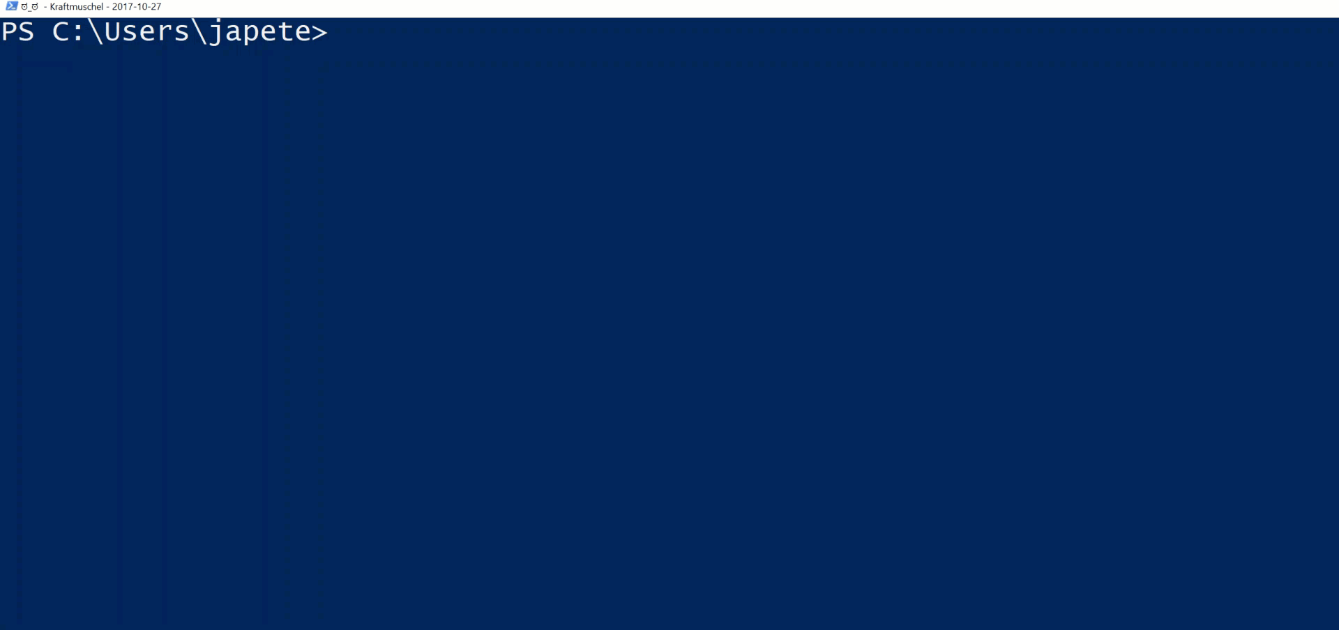
2017
Hands-On JEA
Build an immutable application infrastructure with Nano Server, PowerShell DSC, and the
release pipeline
We want to give you the chance to introduce and advertise yourself. Use the space inside this text box with a bio, picture, personal email, as you like.
This is strictly personal, do not abuse as free advertisement for your employer or other 3rd party.
While you can say that you are working for company ABC, you cannot say that ABC is a wonderful company providing the worlds‘ best services for XYZ. While you can show your email address, do not use a company generic email address like sales@xyz.com
Ravikanth Chaganti

Slide 3

2018
2017
Build an immutable application infrastructure with Nano Server, PowerShell DSC, and the
release pipeline
Hands-On JEA
Ravikanth Chaganti
Jan-Hendrik Peters, Raimund Andrée

Slide 4
Agenda
The basics
DSC Node Registration Endpoint
Offline Domain Join Endpoint
Password-serving Endpoint

Slide 5
The basics
Extension to SessionConfiguration available since dawn of time
Adds RBAC for anything
When used properly, restricts capabilities of connected users
Can run as a gMSA
Can use virtual accounts

Slide 6
The basics - recipe
1 Tbsp of RemoteSessionConfigurationFile
Add RoleCapabilitiesFile to taste
Cook for a couple of seconds
Enjoy your PSSessionConfiguration

Slide 7
New-PSSessionConfigurationFile -Path .\MyConfiguration.pssc -SessionType RestrictedRemoteServer `
-RoleDefinitions @{
'contoso\Group1' = @{RoleCapabilities = 'D:\Role1.psrc'}
'contoso\Group2' = @{RoleCapabilities = 'D:\Role2.psrc'}
}
New-PSRoleCapabilityFile -Path D:\Role1.psrc -VisibleCmdlets Get-Service,Get-Process
New-PSRoleCapabilityFile -Path D:\Role2.psrc -VisibleCmdlets New-Service,Get-Service,Set-Service
Register-PSSessionConfiguration -Path .\MyConfiguration.pssc -Force -Name MyNewEndpoint
Enter-PSSession -ConfigurationName MyNewEndpoint -ComputerName someMachine

Slide 8
Demo
DSC Node Registration Endpoint
Comfortably register your nodes with your DSC pull server

Slide 9
Demo
Offline domain join
Need to transfer the odj file and execute an offline domain join?

Slide 10
Demo
The password oracle
Ask a remote endpoint for encrypted service account passwords, connection strings, …

Slide 11
Summary
JEA is a cool feature
Adds RBAC to anything
Can be used for other purposes as well

Slide 12
Next Steps
Now: 15 min break
Grab a coffee
Stay here to enjoy next presentation
Change track and switch to another room
Ask me questions or meet me in a breakout session room afterwards

Slide 13
Questions?

Slide 14
about_Author
PS C:\Users\japete> Get-Introduction
Name : Jan-Hendrik Peters
Born : 1987-01-24
Profession : Premier Field Engineer @ Microsoft Germany
Years in field : 8
Technologies : {PowerShell, DevOps, DSC, Active Directory}
Hobbies : {Travelling, Brewing, Coding, Hiking}

Slide 15
about_Author
PS C:\Users\raandree> Get-Introduction
Name : Raimund Andrée
Born : 1978-07-31
Profession : PFE @ Microsoft Germany
Years in Field : 23
Technologies : {PowerShell, DevOps, DSC, Active Directory}
Hobbies : {Travelling to high so called risk countries, Coding, Hiking}

